Slide 1
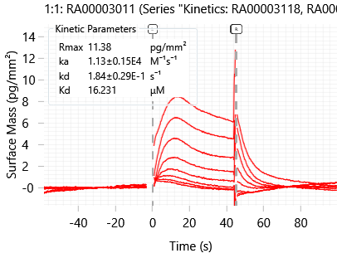
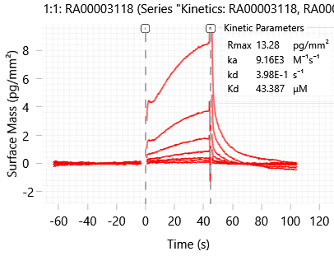
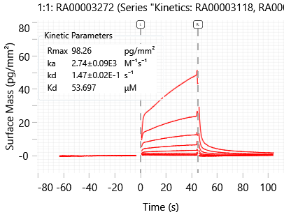
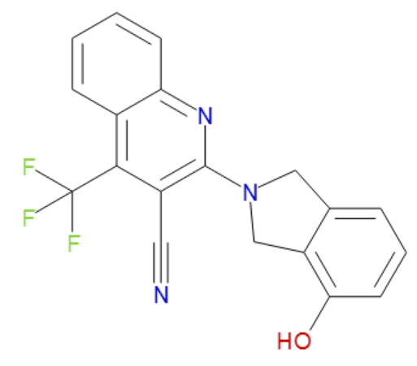
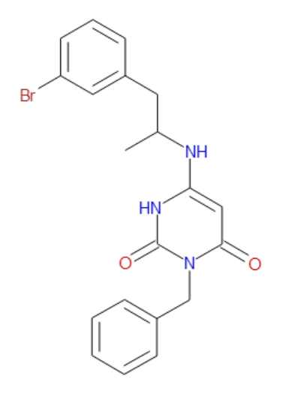
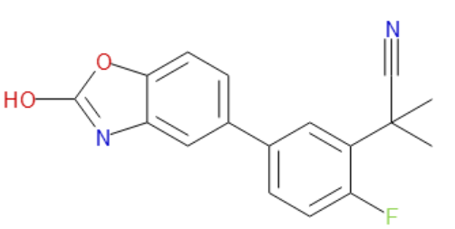
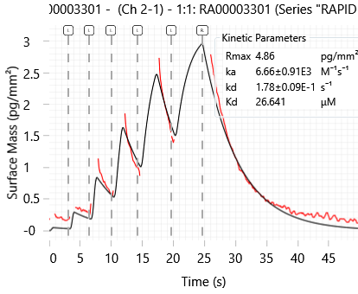
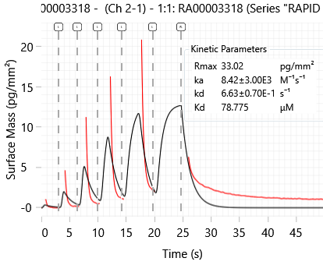
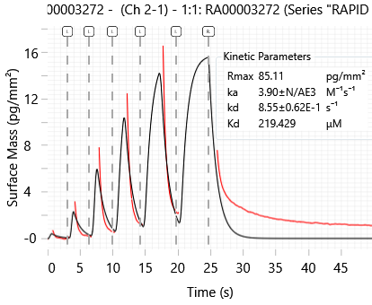
DENV2 Wave Delta CGI analysis of Green Site VS compounds
Traditional Kinetic analysis; (30 µM starting concentration; 8 2-fold dilutions)
UNC10414597A
UNC10414614A
UNC10414568A
RA00003301-01
RA-00003118-01
RA-00003272-01
Kd 16.2 µM
Kd 53.7 µM
Kd 43.4 µM
Rapid Kinetic analysis (30 µM)
Kd 26.6 µM
Kd 78.8 µM
Kd 219.4 µM

Slide 2
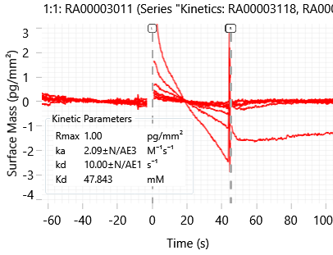
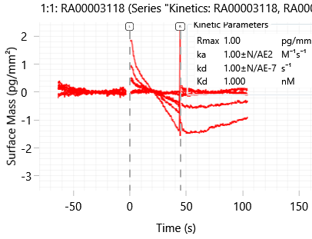
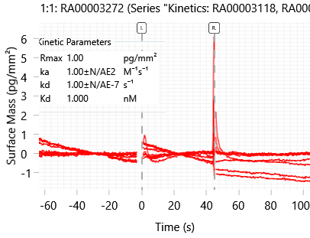
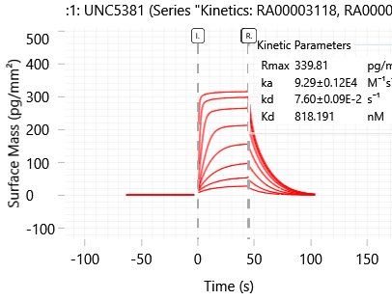
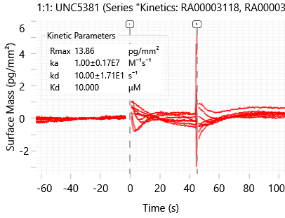
Off-target compound assessment using 53BP1 (Kme reader protein)
53BP1 Control protein
UNC10414597A
UNC10414614A
UNC10414568A
RA00003301-01
RA-00003118-01
RA00003272-01
UNC8531 small molecule ligand for 53BP1
UNC8531
DENV2 UNC8531

Slide 3
Green Site VS compound summary
Anti-viral data:
WaveDelta CGI (traditional kinetics):
RA-0003301-01: 3.4 µM DENV2 EC₅₀, 4.1 µM DENV4 EC₅₀ Kd 16.2 µM
RA-0003318-01: 6.0 µM DENV2 EC₅₀, Not Active (>10uM) DENV4 Kd 43.4 µM
RA-0003272-01: 7.6 µM DENV2 EC₅₀, Not Active (>10uM) DENV4 Kd 53.7 µM
Solubility:
RA-0003301-01 | 1.33 µM
RA-0003272-01 | 2.66 µM
RA-0003318-01 | 9.71 µM

